Slide 1
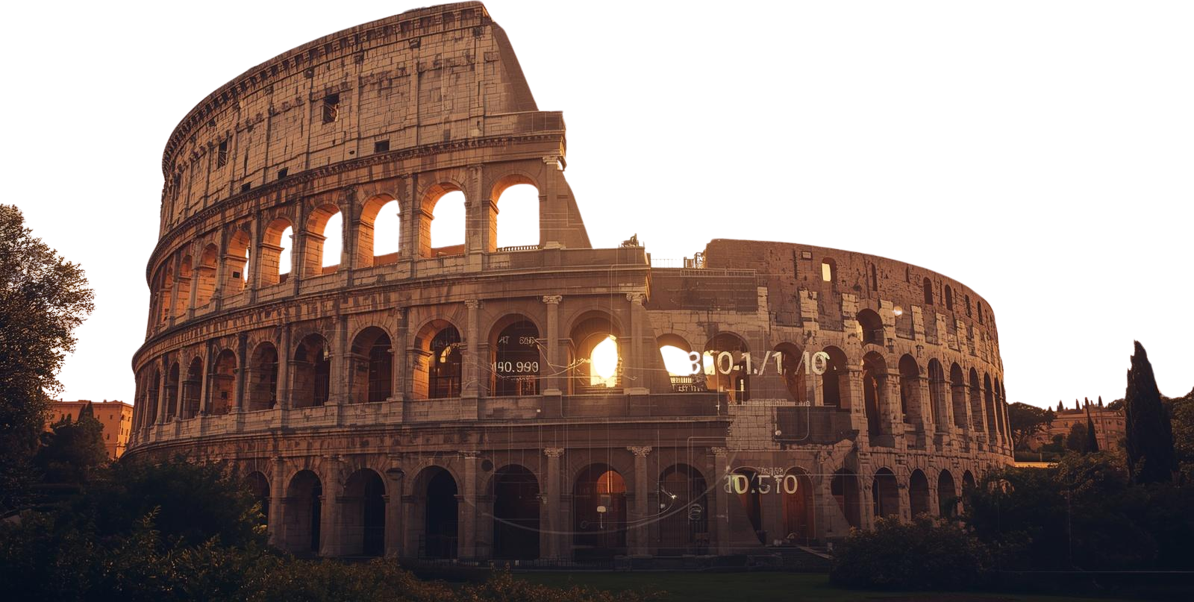
AR/VR Powered Immersive Learning
Historica
Presented By: Monika Choudhary
Atharv Sharma
Khushi Agrawal
Abhishek Rathore Jatin Rao

Slide 2

Introduction
Historica is a web-based AR/VR-powered immersive learning platform designed to transform the way users experience history. The platform provides interactive 3D reconstructions of historical landmarks, civilizations, and events, allowing users to explore ancient environments through modern digital technologies.
The system combines interactive 3D visualization, browser-based Augmented Reality, AI-powered historical simulations, dynamic storytelling, and intelligent virtual avatars to bring history to life.

Slide 3
Problem Statement
Traditional methods of learning history often lack immersive and interactive experiences, while many modern solutions require expensive VR hardware or specialized software. Historica addresses this gap by providing a web-based platform with interactive 3D AR models of ancient landmarks, enabling users to explore historical sites realistically along with educational insights in an accessible and engaging way.

Slide 4
Literature Review
Sr. No. | Name of Solution/System | Features | Limitations/ Drawbacks
1. | Sketchfab (Cultural Heritage) | Allows users to explore 3D models of historical artifacts and sites | No integrated historical storytelling or AR experience
2. | HistoryView VR | Provides virtual reality tours of historical places | Limited 3D reconstructions
3. | National Geographic AR Experiences | Offers interactive 3D models of ancient structures via mobile devices | Not a full-fledged platform for historical site exploration

Slide 5



Core Technologies
Interactive 3D Visualization
Explore detailed 3D reconstructions of historical landmarks and ancient civilizations with full navigation control and immersive detail.
Browser-based Augmented Reality
Experience history through AR directly in your browser—no app downloads required. Bring artifacts and monuments to life.
AI-powered Historical Simulations
Witness dynamic recreations of historical events powered by artificial intelligence, creating authentic and educational experiences.

Slide 6



Key Features
1
Dynamic Historical Storytelling - Experience history through narrative-driven journeys that adapt to your interests and learning pace.
2
Intelligent Virtual Avatars - Interact with AI-powered historical figures who guide you through ancient civilizations and events.
3
Immersive Environment Exploration - Walk through fully reconstructed 3D historical sites and landmarks in stunning detail.

Slide 7


Target Audience
Historica enables students, researchers, educators, and history enthusiasts to visualize historical sites and experience ancient environments through modern digital technologies.
Our platform serves:
• Students seeking engaging ways to learn history
• Researchers exploring historical reconstructions
• Educators creating immersive lesson plans
• History enthusiasts passionate about the past
By bridging technology and heritage, Historica transforms passive learning into active exploration.

Slide 8

Preserving the Past, Inspiring the Future
Thank You!
Team Historica

